Slide 1
Data Exchange Program
Information Session for CSB Leaders
4 Mar 2022

Slide 2
The wonders of modern technology…
It’s common knowledge that our system struggles with data-related challenges:
Our CCS3/CARS and Taxonomy process causes rework and data mapping for CSBs.
Our agency data platforms make warehousing, manipulating, and reporting on data difficult.
CSBs are deluged with data calls, multiple platforms, various roll-outs and updates, and more.
This list could go on and on…
Nobody involved is satisfied with where we are.

Slide 3
A vision for the future
A truly modernized data exchange and management platform
Built upon standard and interoperable data definitions
Scalable to adapt as the system evolves
Capable of resolving inefficiencies, slashing administrative burden, and freeing up valuable resources for mission-oriented work
Benefits include:
Unification of platforms
Elimination of unnecessary data mapping and rework
Data warehouse capable of self-service reporting
Operational analytics support strategic and tactical decision making at all levels
…and more

Slide 4
Getting there
Challenges abound:
Workforce shortage
COVID-19 pandemic
New administration*
Battling through current state to keep services online
Dealing with the new while tolerating the old
On top of that, DBHDS has an up-and-down track record with rolling out similar projects in the past.

Slide 5
Commitment
The DBHDS team is committed to ensuring this is successful.
‘The most important initiative we have right now.’
‘We will be a data-driven organization.’
We are in the beginning stages and there will be much more to come, including a communications plan to ensure communications are handled well.

Slide 6
Taxonomy & Data Definitions
A fundamental component of this work is the modernization of our taxonomy and CCS3 system.
Tentative project scope:
Create a framework for defining data elements utilized by our providers to simplify data acquisition, management, storage, warehousing, and utilization.
The framework will leverage industry-standard taxonomic definitions, previous taxonomy work within the system, and other best practices to ensure maximal interoperability.
The framework will be scalable to allow for future evolution without having to teardown and rebuild.

Slide 7
Latest Updates:
We’ve enlisted top-flight consultant assistance to help us put arms around this massive undertaking.
Excerpt from the Statement of Work:
Objective 1:
Understand current challenges with the data exchange between CSBs, DBHDS and other key entities (e.g., other state agencies, Federal partners)
Work collaboratively with the individuals who have been leading in this area
Gather stakeholder input regarding current practices and preferences

Slide 8
Objective 1 Continued
Interviews: Assume 5-10 across key stakeholders co-developed with DBHDS (e.g., leadership, CSBs, other providers)
Identify potential options and impact of each across the full ecosystem
Facilitate stakeholder information and agreement sessions to gain consensus on optimal approaches
Create an action plan including timelines and stakeholder responsibilities to achieve transition

Slide 9
Deliverables
Inventory and Impact Analysis of all systems and datasets impacted by taxonomy work.
Architecture diagram of recommended future state Data Exchange System to meet collective needs.
Action Plan laying out steps toward implementation.

Slide 10
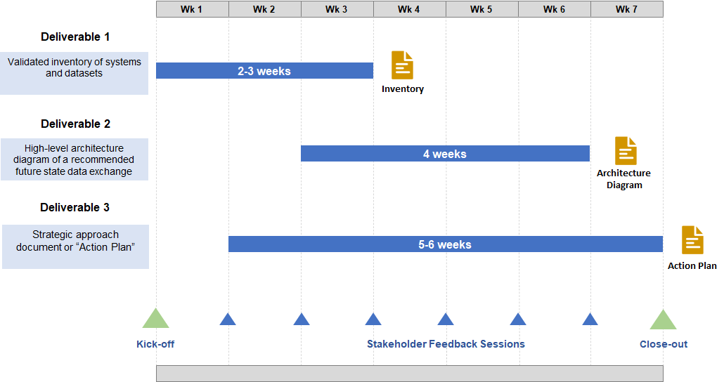
Consultant Project Timeline

Slide 11
Additional Program Updates/Questions
Reiterating:
We are in the very early stages of this initiative
We are committed to a collaborative effort on this
We have assembled several leaders from our IT and Data world to provide the very latest updates and answer any questions you may have.

Slide 12
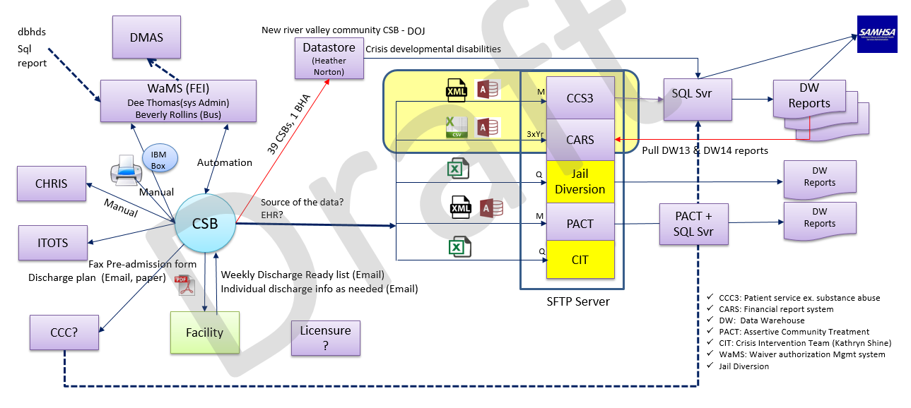
CSB Current State Diagram

Slide 13
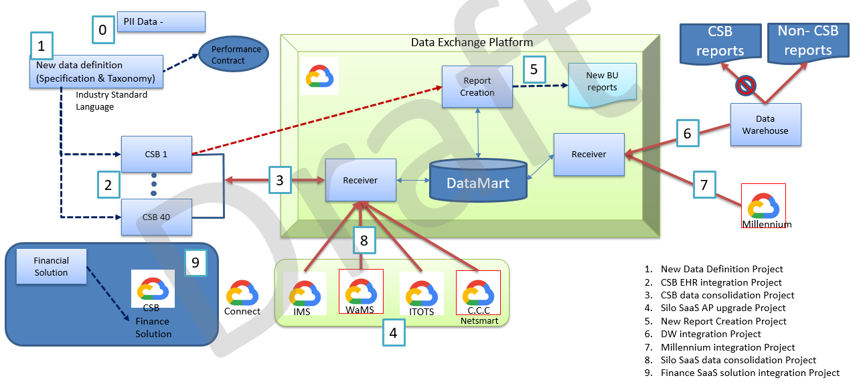
Concept Diagram: Data Exchange

